Slide 1
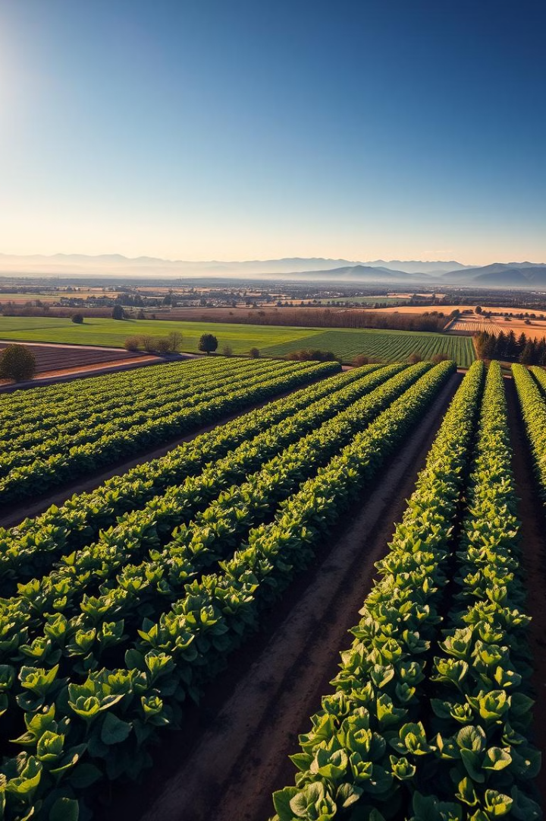
AgriBrain 2.0: AI-Driven Precision Farming Assistant
Revolutionizing agriculture with data-driven insights. Team Members:
Engr. Jalal Saleem (Leader)
Muhammad Abdullah
Engr. Uzair Yusuf
Hafiz Syed Habib Ahmad Gillani
Tayyab Mahboob Ahmad
Azeem Siddique

Slide 2
The Challenge: Maximizing Crop Yields
Inconsistent Yields
Inefficient Resource Use
Limited Decision Support
Fluctuating crop production
Overuse and misuse of fertilizers
Lack of real-time insights for farmers

Slide 3
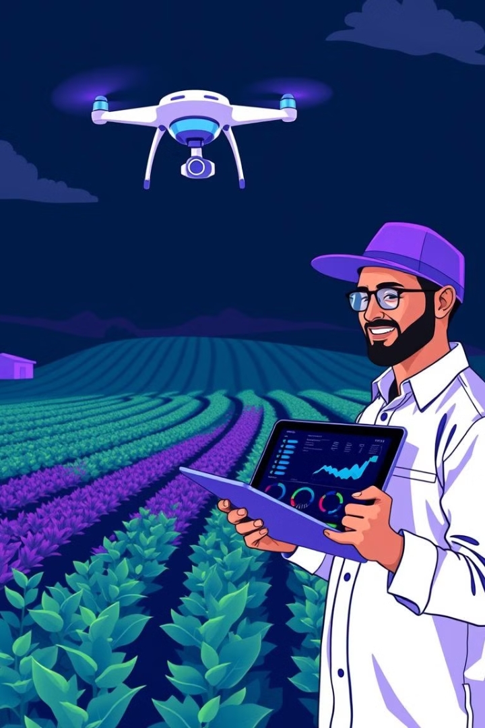
AgriBrain 2.0: The Solution
1
AI-Powered Insights
2
Real-time Decision Support
Data-driven recommendations for optimal farm management
Empowering farmers with timely insights
3
Future Integration
IoT and computer vision for continuous monitoring and automation

Slide 4
AI-Powered Insights: Data Acquisition & Processing
Historical Data
External Datasets
Predictive Analytics
Leveraging past farm data for analysis
Weather data from public APIs
ML models for yield forecasting and crop health monitoring

Slide 5

Data-Driven Recommendations: RAG-Based LLM
Knowledge Retrieval
Actionable Recommendations
Access to relevant information from ChromaDB
AI-driven advice on crop health, resource optimization, and pest control

Slide 6
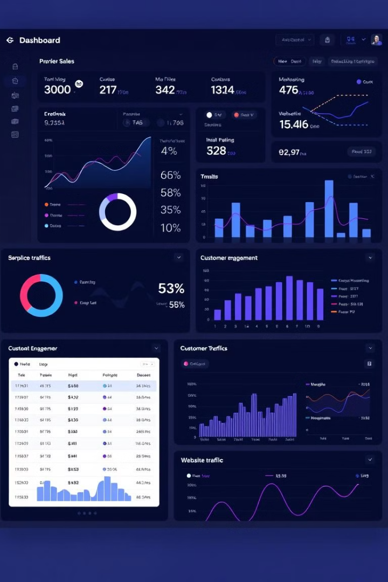



Interactive Dashboard & Reporting
React-based user interface for seamless navigation
Data visualization tools powered by D3.js
Exportable reports in Excel and PDF formats

Slide 7
AgriBrain 2.0 Workflow: A Seamless Process
Data Collection
1
Gather historical and external datasets
2
Data Processing
ML model predictions for yield forecasting and crop health
Data Embedding
3
Store and retrieve data using ChromaDB
4
Query Handling
Chatbot interface for user queries and interaction
AI Recommendations
5
Generate actionable insights and advice
6
Report Generation
Produce comprehensive reports in various formats

Slide 8
Work Breakdown Structure: Comprehensive Planning
Project Planning
Define scope, goals, and timeline
Data Integration
Gather and prepare data from various sources
ML Model Development
Develop and train machine learning models
Data Embedding
Store and retrieve data using ChromaDB
Frontend Development
Build user interface and dashboard
Testing & Deployment
Ensure quality and reliability of the system

Slide 9
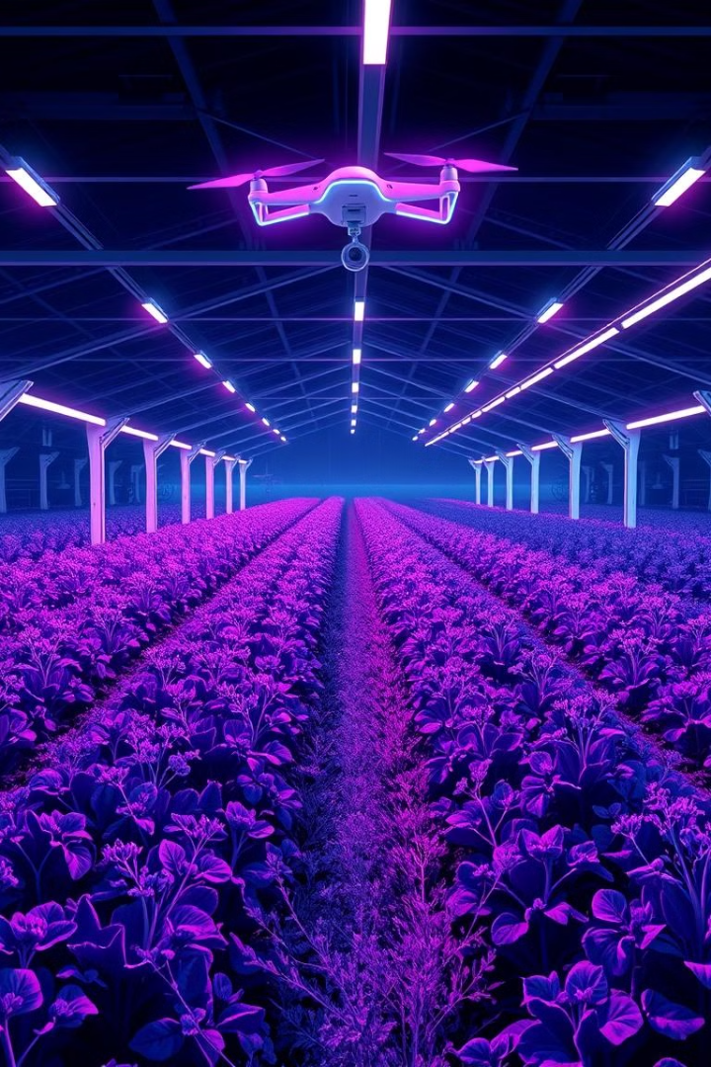


Future Extensions: Enhancing AgriBrain 2.0
IoT Integration
Real-time data collection from farm sensors
Computer Vision
Automated pest detection, soil condition monitoring, and crop health assessment

Slide 10
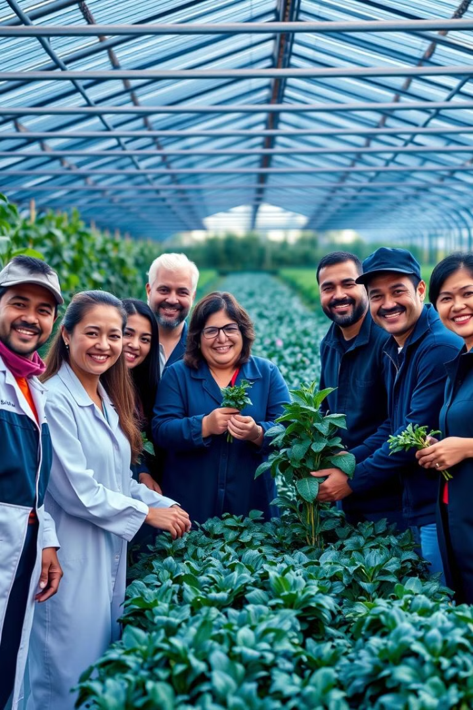
Conclusion: The Future of Agriculture
AgriBrain 2.0 empowers farmers with AI-powered insights for increased efficiency, sustainability, and profitability. The future of agriculture is data-driven, and we are leading the way.

